Slide 1
Forecasting London House Prices
Using Time Series Modelling to Forecast which London Postcodes to invest in
Andrew Rowan, Flatiron School

Slide 2

Business Problem
Buying a house is usually the purchase any of us will make and so often we are limited to viewing a house just twice before purchasing!
In a city like London that is so vast and difficult to have intimate knowledge of every area, a tool to inform you if a Postcode is a safe investment would be invaluable.

Slide 3


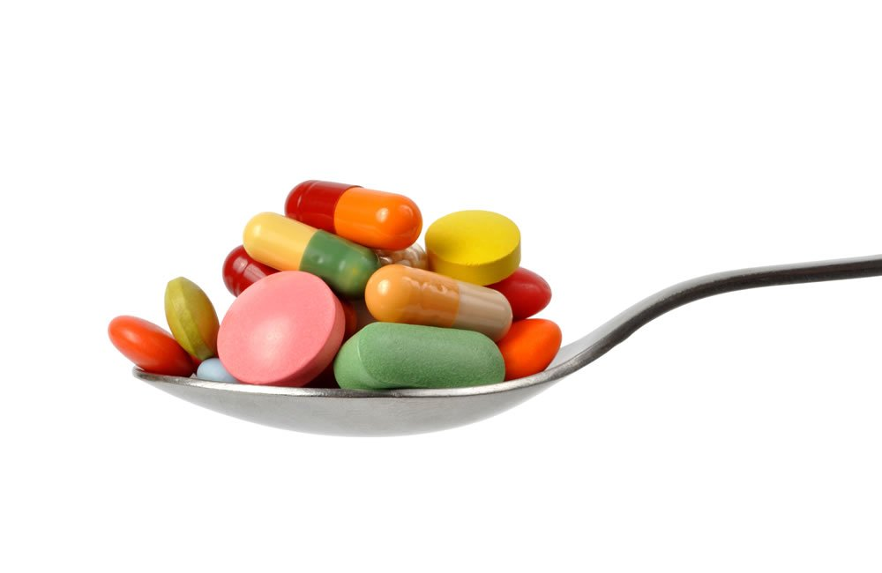
Who would this help?
Anybody buying property!
Save Time
Prevent misdiagnoses – bad for both individuals and hospitals
References: 1, 2, 3
Notes:
Save money, administration costs to get healthy patients further appointments, administering drugs they don’t need,
Save time – consultants could be working on other cases, also if a patient has another serious issue then saving time is vital. If a patient does have pneumonia early diagnoses is vital.
The misdiagnoses are bad for patients and hospitals. They lead to inappropriate use of a broad spectrum of antibiotics as therapy for healthcare-associated pneumonia, and in the future may not be paid for by CMS under the Hospital-Acquired Conditions initiative, according to researchers

Slide 4
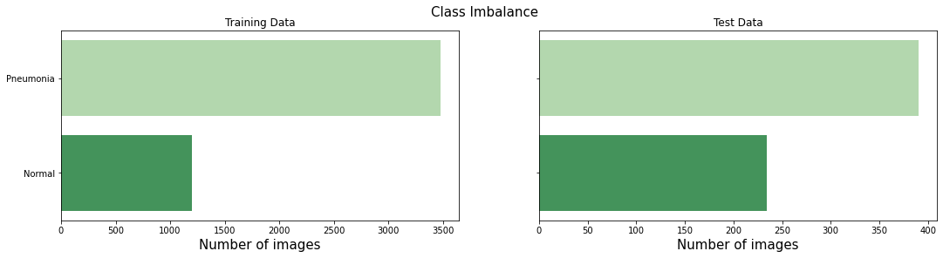
Data
Data downloaded directly from Kaggle.
5,856 x-ray images in the dataset
Clear class imbalance in Train, Test and Val sets with ‘Normal’ class in the minority
CRISP-DM Process Model ³

Slide 5
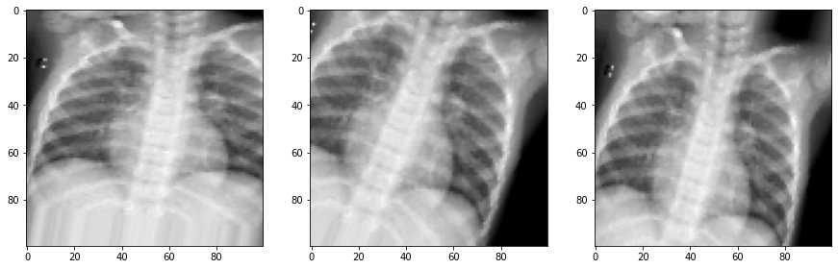
Data Augmentation
Model training supplemented with the use of Data Augmentation

Slide 6
Models & Results
Model | Accuracy | Recall | Precision | F1
Base NN | 0.81 | 0.97 | 0.78 | 0.87
Base CNN | 0.763 | 0.99 | 0.73 | 0.84
CNN + Dropout | 0.764 | 0.99 | 0.73 | 0.84
Deep CNN + Dropout | 0.81 | 0.99 | 0.77 | 0.87
Deep CNN Dropout L2 | 0.78 | 0.99 | 0.74 | 0.85
Data Augmentation | 0.93 | 0.98 | 0.91 | 0.95
Results in the table above reflect model scores on the hold out data set and where applicable, relate to only Pneumonia class.

Slide 7
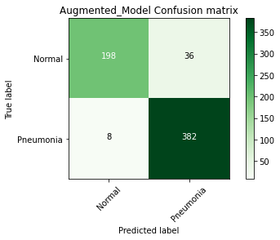
Final Model
The model that utilised data augmentation provided the best results on hold out data.
Accuracy of 0.93
Strong recall scores in both classes (0.85 and 0.98) for Normal and Pneumonia respectively.

Slide 8
Conclusions & Recommendations
Priority here is to catch pneumonia…but there needs to be a balance.
Model selected has highest accuracy overall (0.93) but not highest recall for Pneumonia class (0.98 vs highest 0.99)
Misdiagnosing healthy patients or patients with other ailments is also damaging and should be avoided.
Recommend trialling this model with more real world test data

Slide 9
Further Work
Pretrained Models
More Data
Address Class imbalance
Utilise cloud based computing to tune more complex models

Slide 10
References
1. https://www.thestreet.com/personal-finance/hospital-refunds-patients-rsquo-money-when-complaints-are-filed-13578020
2. Shutterstock
3. https://watertreatmentservices.co.uk/news/antibiotics-antimicrobial-protection-good-bye-to-antibiotics/

Slide 11
Thank You!
Email: adrowan88@gmail.com

